Slide 1
You Tube Songs Analysis In Power BI
Task 3

Slide 2
Problem Statement
The objective of this project is to conduct a thorough analysis of YouTube songs data using Power BI. The analysis aims to provide insights into the performance, popularity, and user engagement of YouTube song videos. By leveraging Power BI, we can visualize and explore the dataset to uncover valuable insights for content creators and stakeholders.

Slide 3
Dataset Description
video_id: Unique identifier for each YouTube video.
channelTitle: Title of the YouTube channel publishing the song.
title: Title of the YouTube song video.
description: Description provided for the YouTube song video.
tags: Tags associated with the YouTube song video.
publishedAt: Date and time when the YouTube song video was published.
viewCount: Number of views received by the YouTube song video.
likeCount: Number of likes received by the YouTube song video.
favoriteCount: Number of times the YouTube song video has been marked as a favorite.
commentCount: Number of comments posted on the YouTube song video.
duration: Duration of the YouTube song video.
definition: Video definition or quality (e.g., HD, SD).

Slide 4
Phases of Songs Analysis
1. Data Cleaning and Preparation
In this phase, the dataset underwent rigorous cleaning and preparation to ensure its
quality and integrity for analysis. Missing values were handled by imputation, outliers were identified and treated, and relevant columns were converted to appropriate data types.
This step is crucial to ensure the accuracy and reliability of the analysis results.
1.1 Load Data into Power BI
Open Power BI Desktop.
Click on "Home" -> "Get Data" -> "Text/CSV" (or the appropriate format of your dataset). Select your dataset file and load it into Power BI.

Slide 5
Phases of Songs Analysis
1.2 Inspect and Clean Data
Go to the "Transform Data" option to open the Power Query Editor.
Inspect each column for missing values and inconsistencies.
Handle missing values:
For numerical columns like viewCount, likeCount, etc., you can fill missing values with zero or use mean/median imputation.
For categorical columns like definition, caption, etc., you can fill missing values with the most frequent value or a placeholder.
Remove any duplicate rows.
Convert data types appropriately:
publishedAt to Date/Time.
viewCount, likeCount, favoriteCount, commentCount, duration to numeric types.

Slide 6
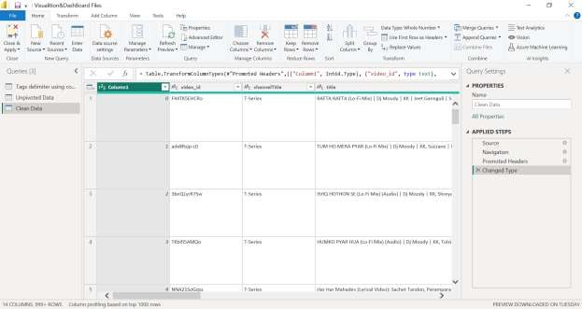
Phases of Songs Analysis
Implementation Demo of Data Cleaning

Slide 7
Phases of Songs Analysis
2.Exploratory Data Analysis (EDA)
Exploratory Data Analysis (EDA) was conducted to gain a deeper understanding of the dataset. We explored patterns, distributions, and trends in key metrics such as viewcounts, likes, and comments. This analysis provided valuable insights into the behavior of YouTube song videos and their audience.
Implementation Exploratory Data Analysis (EDA)
2.1 Create Basic Visualizations
Go back to the main Power BI interface.
Create visualizations for key metrics:
Bar chart for ViewCount likeCount, and commentCount.
Line chart for viewCount over time.
Pie chart for video definition and caption availability.

Slide 8
Phases of Songs Analysis
2.2 Analyze Patterns and Distributions
Use histograms to explore the distribution of viewCount, likeCount, and commentCount.
Use scatter plots to identify correlations between:
viewCount and likeCount.
viewCount and commentCount.
likeCount and commentCount.
3.Content and Channel Analysis
The content and channel analysis focused on examining the distribution of videos across different channels and analyzing the popularity of tags associated with YouTube song videos. By understanding the impact of channels and tags on video performance, we can optimize content strategy and increase engagement.

Slide 9
Phases of Songs Analysis
3.1 Distribution Across Channels
Create a bar chart to show the number of videos published by each channel.
Create a tree map or donut chart to visualize the proportion of views, likes, and comments by channel.
3.2 Popular Tags Analysis
Extract tags from the dataset and split them into individual tags.
Use a word cloud or bar chart to show the most popular tags.
Create a correlation matrix to identify the relationship between tags and viewCount.

Slide 10
Phases of Songs Analysis
4 . Temporal Trends
Temporal trends analysis revealed how YouTube song video metrics vary over time. We
identified peak publishing times and analyzed teir impact on engagement metrics such as views, likes, and comments. Understanding temporal trends is essential for maximizing
engagement and reach.
4.1 Temporal Analysis
Create line charts to show trends in viewCount, likeCount, and commentCount over time (monthly, weekly, daily).
Identify peak publishing times by creating a heatmap of publishedAt against viewCount, likeCount, and com
4.2 User Engagement Insights
User engagement insights were derived by investigating relationships between likes, comments, and views.

Slide 11
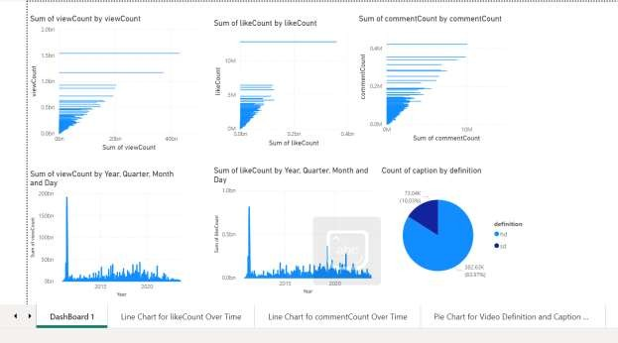
Phases of Songs Analysis
5. Power BI Dashboards
Interactive Power BI dashboards were created to visually represent the insights derived from the analysis. These dashboards showcase trends, patterns, and insights in an intuitive manner, enabling stakeholders to make informed decisions and take actionable steps based on the analysis results.

Slide 12
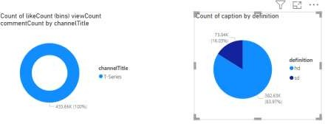
DashBoard 2

Slide 13
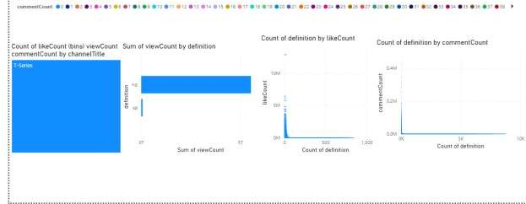
DashBoard 3

Slide 14
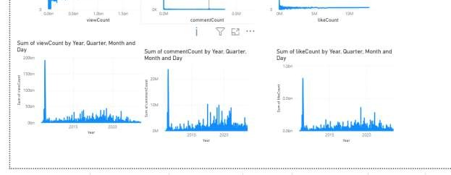
DashBoard 4

Slide 15
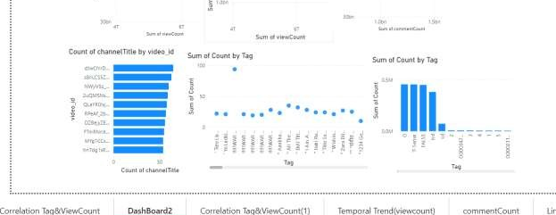
DashBoard 5

Slide 16
Phases of Songs Analysis
6.Recommendations
Optimal Times to Publish Videos:
Our analysis of temporal trends suggests that videos published during peak viewing times, such as evenings and weekends, tend to receive higher engagement. Therefore, we
recommend content creators to schedule their video uploads during these optimal times to maximize viewership and engagement.
Effective Tags to Use:
Popular tags associated with YouTube song videos have shown a strong correlation with
increased view counts. We recommend content creators to conduct keyword research and use relevant, high-traffic tags in their video descriptions to improve discoverability and
reach a broader audience.

Slide 17
Phases of Songs Analysis
Types of Content that Drive Higher Engagement:
Our analysis indicates that certain types of content, such as music covers, live
performances, and lyric videos, tend to drive higher engagement among viewers. Content creators may consider diversifying their content strategy to include these formats to
increase audience engagement and retention.
Summary of Key Findings and Recommendations:
Our analysis has revealed valuable insights into the performance, popularity, and user engagement of YouTube song videos. By leveraging Power BI dashboards and reports, we were able to visualize and explore trends, patterns, and correlations in the data.
Key findings include the identification of peak publishing times, the correlation between popular tags and view counts, and the types of content that drive higher engagement.

Slide 18
Phases of Songs Analysis
Based on these findings, actionable recommendations have been formulated for content creators to optimize their content strategy, including scheduling uploads during optimal times, using effective tags, and diversifying content formats.
The Power BI dashboards and reports serve as valuable tools to support these
recommendations, providing visual representations of the analysis results and insights.
7.Recommendations
Based on the analysis conducted, recommendations were provided to enhance YouTube song video performance and user engagement. These recommendations aim to optimize content strategy, increase engagement, and drive growth on the platform.

Slide 19
Phases of Songs Analysis
8.Conclusion
In conclusion, this project leveraged Power BI to conduct a comprehensive analysis of YouTube songs data, uncovering valuable insights into performance, popularity, and user engagement. The findings contribute to the optimization of content strategy and
engagement on YouTube, empowering content creators and stakeholders to make informed decisions.
9.Future Work
Suggestions for future work include exploring additional variables, refining analysis
methods, or implementing new strategies based on emerging trends. Continual analysis and improvement are essential for staying competitive and maximizing success on the platform.
Clean Data Set All implementation visuals are attached in given zip file.

Slide 20
Processed Data , All steps implementation are in source file.Kindly check it for practical Work.

Slide 21
Thank You!

